Slide 1

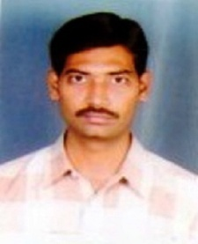
Introduction to Programming and Problem Solving
Problem Solving And Programming Using C
Presented By:
Mr.L.V.Kiran
Assistant Professor
MCA
GIET (A)
Lecture Details:
Topic-1, Basics of C Programming(Unit-1)
B.Tech, I Semester

Slide 2
Contents
What is C ?
Why do we use C ?
History of C Language
Features of C Language
Structure of a C program
Program Development Steps
Header files and Processor Directives

Slide 3
What is C ?
C is a general-purpose programming language
C is also said to be structured programming language or function oriented programming language
C is a High level programming language

Slide 4
Why do we use C?
C language is used to create applications or software
Initially, C was developed to create an operating system called UNIX
The popular software like Linux OS, PHP & MySQL are created using C language

Slide 5
Why do we use C?
Generally C Language is used to create the following…
  Operating Systems
  Language Compilers
  Assemblers
  Interpreters
  Text Editors
  Network Drivers
  Databases

Slide 6
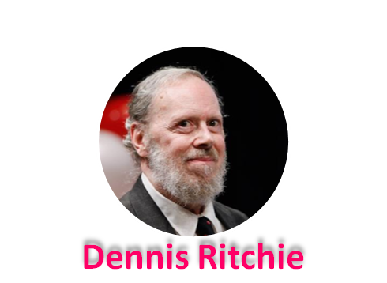
History of C Language
C Language was developed by Dennis Ritchie in the year of 1972
Born – September 9, 1941
Profession – Computer Scientist
Place – Bell Labs, US
Known As – Father of C & UNIX
Awards Turing Award(1983)
National Medal of Technology(1998)
IEEE Medal(1990)
Computer Pioneer Award(1994)
Computer History Museum Fellow(1997)
Harold Pender Award(2003)
Died – October 12, 2011

Slide 7
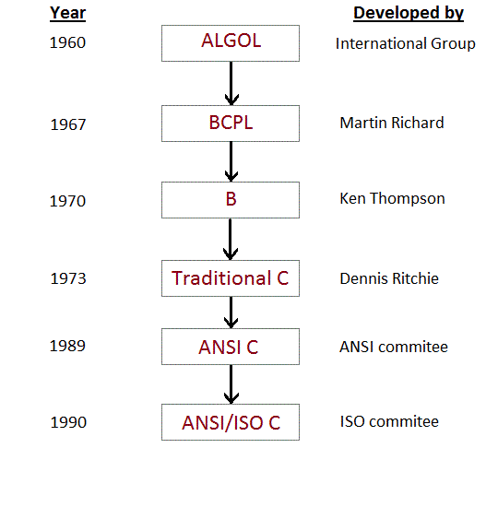
History of C Language

Slide 8
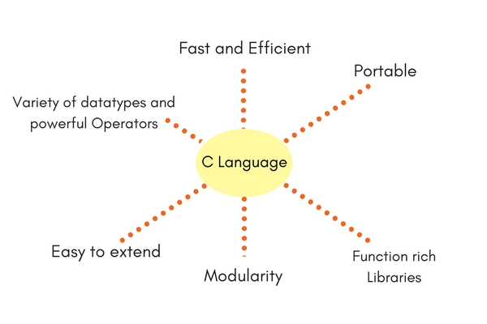
Features of C language

Slide 9
